Slide 1





Redux State Management
Introduction to Redux.
Implementing NgRX and NgXS.
Redux NgRX & NgXS
SoftUni Team
Technical Trainers
Software University
http://softuni.bg

Slide 2

Table of Contents
Introduction to Redux
NgRX Store
Store & App State
Actions
Reducers
Dispatching actions
NgXS – Alternative to NgRX

Slide 3
Have a Question?
sli.do #js-web

Slide 4

Introduction to Redux
What is state management ?

Slide 5
Introduction to Redux
Redux isn't just a React thing
Redux:
Predictable state management
Enjoyable developer workflow
Pure functions
First class level support for Angular
Comes with TypeScript bindings
“Redux attempts to make state mutations predictable by imposing certain restrictions on how and when updates can happen”
http://redux.js.org

Slide 6
Introduction to Redux (2)
Redux state
Single source of truth
State is read only
Pure functions drive state changes
Unidirectional data-flow
Warning – do not use it for simple applications!

Slide 7
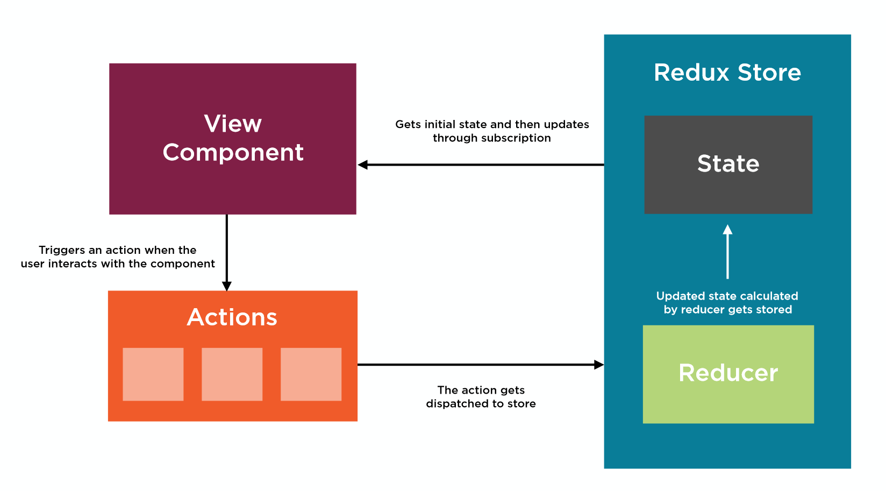
How does state management work ?

Slide 8
Implementing NgRX
Using the famous pattern

Slide 9
NgRX Store
NgRX store is an RxJS powered state management tool for Angular
Helps build robust apps by better organizing app state
Without it dealing with complex data across multiple components can become quite difficult to handle and test
Installation:
npm install @ngrx/store --save

Slide 10
Models and App State
Create a folder store in src/app and inside create a model
Create the App State:
export interface Course {
name : string;
url : string;
}
export interface AppState {
readonly courses: Course[]
}
State should be immutable

Slide 11
Create Actions
An action in ngrx/store is two things:
A type in the form of a string. It describes what is happening
It contains a payload of data.
Create an actions folder and inside define all actions
import { Action } from '@ngrx/store';
import { Course } from '../../models/course.model';
export const ADD_COURSE = '[COURSE] Add';
export const REMOVE_COURSE = '[COURSE] Remove';

Slide 12
Create Actions (2)
An action to add items in a list:
An action to remove items from a list:
export class AddCourse implements Action {
readonly type: string = ADD_COURSE;
constructor(public payload : Course) { }
}
export class RemoveCourse implements Action {
readonly type: string = REMOVE_COURSE; constructor(public payload : number) { }
}
export type Actions = AddCourse | RemoveCourse;

Slide 13
Create a Reducer
A reducer is what takes the incoming action and decides what to do with it
It takes the previous state and returns a new state based on a given action
Create a reducers folder and inside define our only reducer. We will need the created actions and a pure reducer function.

Slide 14
Create a Reducer (2)
const initialState : Course = {
name: 'Angular Fundamentals July 2018',
url: 'https://softuni.bg/trainings/2037/angular-fundamentals-july-2018'
}
export function reducer(state : Course[] = [initialState], action: CourseActions.Actions) {
switch(action.type) {
case CourseActions.ADD_COURSE:
return [...state, action.payload];
default:
return state;
}
}
Return the old state + the payload

Slide 15
Update the App Module
We need to import @ngrx/store and our reducer
import { StoreModule } from '@ngrx/store';
import { reducer } from './reducers/tutorial.reducer';
@NgModule({
// Other code removed for brevity
imports: [
BrowserModule,
StoreModule.forRoot({
tutorial: reducer
})
],
// Other code removed for brevity

Slide 16
Reading from NgRX Store
Generate two components read and create using the CLI
export class ReadComponent implements OnInit {
courses : Observable<Course[]>;
constructor(
private store : Store<AppState>
) { }
ngOnInit() {
this.courses = this.store.select('courses');
}
}

Slide 17
Read Component Template
The read component should have the following template:
<div class="right">
<h3>Courses</h3>
<ul>
<li *ngFor="let course of courses | async; let i = index">
<a [href]="course.url" target="_blank">{{ course.name }}</a>
<button (click)="delCourse(i)">Delete Course</button>
</li>
</ul>
</div>
We will implent deleting later on

Slide 18
Add Styling & Render Components
Add the following styling inside styles.css
body, html {
margin: 0;
padding: 0;
font-family: 'Arial';
}
.left, .right {
float:left;
width: calc(50% - 6em);
padding: 3em;
}
input[type="text"] {
width: 100%;
padding: 5px;
margin-bottom: 10px;
}
<app-create></app-create>
<app-read></app-read>
Render inside app.component.html

Slide 19
Writing to NgRX Store
Write to NgRX Store calling our add course action:
export class CreateComponent implements OnInit {
constructor(private store : Store<AppState>) { }
addCourse(name, url) {
this.store.dispatch(new CourseActions.AddCourse({name : name, url: url}));
}
}
Send the payload to the reducer

Slide 20
Create Component Template
The create component should have the following template:
Test the app to see if the writes correctly!
<div class="left">
<input type="text" placeholder="name" #name>
<input type="text" placeholder="url" #url>
<button (click)="addCourse(name.value,url.value)">Add a Course</button>
</div>

Slide 21
Removing from NgRX Store
Call our remove tutorial action and pass in an index:
import * as CourseActions from '../store/actions/course.actions';
// In the class, add:
delTutorial(index) {
this.store.dispatch(new CoursesActions.RemoveCourse(index))
}

Slide 22
Removing from NgRX Store (2)
Finish the reducer so it deletes items from the state by index:
function removeCourse(state, action: CourseActions.RemoveCourse) {
const itemToRemove = state[action.payload];
return [...state.filter(a => a !== itemToRemove)];
}
export function reducer(…) {
switch(action.type) {
case CourseActions.REMOVE_COURSE:
return removeCourse(state, action as CourseActions.RemoveCourse);
}
}
We have implemented a basic store ☺

Slide 23

NgXS
An alternative way to manage state

Slide 24
NgXS Store
Ngxs is a different approach to Angular state management that offers a few benefits, namely less boilerplate code.
Installation:
npm install @ngxs/store --save
npm install @ngxs/logger-plugin @ngxs/devtools-plugin --dev
Works with Redux Devtools chrome extension
Outputs state in the console

Slide 25
Defining Actions
Create two actions:
import { Course } from '../../models/course.model';
export class AddCourse {
static readonly type = '[COURSE] Add'
constructor(public payload: Course) {}
}
export class RemoveCourse {
static readonly type = '[COURSE] Remove'
constructor(public payload: string) {}
}
Notice that fields are static

Slide 26
Defining a State
A key difference between Ngrx and Ngxs is how the state is handled. The state file(s) in Ngxs take the place of reducers in Ngrx. This is done by utilizing various decorators.
import { State, Action, StateContext, Selector } from '@ngxs/store';
import { Course } from '../../models/course.model';
import { AddCourse, RemoveCourse } from '../actions/course.actions';
export class CourseStateModel {
courses: Course[];
}

Slide 27
Defining a State (2)
@State<CourseStateModel>({
name: 'courses',
defaults: {
courses: []
}
})
export class CourseState {
@Selector()
static getCourses(state: CourseStateModel) {
return state.courses
}
// continued in next slide
}

Slide 28
Defining a State (3)
@Action(AddCourse)
add({getState, patchState }: StateContext<CourseStateModel>,
{ payload }:AddCourse) {
const state = getState();
patchState({
courses: [...state.courses, payload]
})
}
@Action(RemoveCourse)
remove({getState, patchState }: StateContext<CourseStateModel>, { payload }
:RemoveCourse) {
patchState({
courses: getState().courses.filter(a => a.name != payload)
})
}

Slide 29
Update App Module
import { NgxsModule } from '@ngxs/store';
import { CourseState } from './store/state/course.state';
import { NgxsReduxDevtoolsPluginModule } from '@ngxs/devtools-plugin';
import { NgxsLoggerPluginModule } from '@ngxs/logger-plugin';
@NgModule({
...
imports: [
BrowserModule,
NgxsModule.forRoot([
CourseState
]),
NgxsReduxDevtoolsPluginModule.forRoot(),
NgxsLoggerPluginModule.forRoot()
],
...
})
export class AppModule { }

Slide 30
Adding Courses to State
Adding is similar to Ngrx:
import { Store } from '@ngxs/store';
export class CreateComponent implements OnInit {
constructor(private store: Store) { }
addCourse(name, url) {
this.store.dispatch(new AddCourse({name: name, url: url}))
}
}

Slide 31
Reading & Deleting from the State
We've written to the state, let's read from it now:
export class ReadComponent implements OnInit {
courses$: Observable<Course>
constructor(private store: Store) {
this.courses$ = this.store.select(state => state.courses.courses)
}
delCourse(name) {
this.store.dispatch(new RemoveCourse(name))
}
}

Slide 32
Using Selector
You can make use of the state's Selector function for returning the state in even less code:
export class ReadComponent implements OnInit {
// courses$: Observable<Course>
@Select(CourseState.getCourses) courses$: Observable<Course>
constructor(private store: Store) {
// this.courses$ = this.store.select(state => state.courses.courses)
}
}

Slide 33

Summary
Understanding Redux State Management
NgRX store is a state management tool
NgXS is a different approach with less boilerplate code
npm install @ngrx/store --save
npm install @ngxs/store --save
npm install @ngxs/logger-plugin @ngxs/devtools-plugin --dev

Slide 34












Redux State Management
https://softuni.bg/courses/

Slide 35
License
This course (slides, examples, demos, videos, homework, etc.) is licensed under the "Creative Commons Attribution-NonCommercial-ShareAlike 4.0 International" license
Attribution: this work may contain portions from
"End-to-end JavaScript Applications" course by Telerik Academy under CC-BY-NC-SA license

Slide 36





Trainings @ Software University (SoftUni)
Software University – High-Quality Education, Profession and Job for Software Developers
softuni.bg
Software University Foundation
http://softuni.foundation/
Software University @ Facebook
facebook.com/SoftwareUniversity
Software University Forums
forum.softuni.bg

